Slide 1
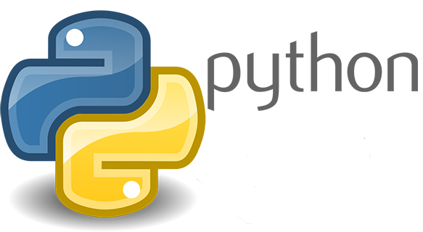
Python for Beginners
Syntax and Libraries

Slide 2
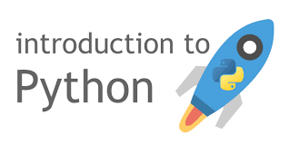

Slide 3
Python ?
Object-oriented, high-level, interpreted language.
Dynamic typing, dynamic binding.
Modules and packages - modularity.
Can be used from a script file or the Python shell.
Popular IDEs: Visual Studio, PyCharm

Slide 4
Let’s get going !
import os
from numpy import random
from matplotlib import pyplot as plt
name = ‘randomname’
anothername = ‘namerandom’
variable,var = 17,97
# this line is a comment
print ”Hello World !”
“””
This is a multiline comment
”””
print variable * var
print name + anothername
Keywords
Identifiers
Literals
Punctuators
Operators

Slide 5
Conditionals and Loops
for i in xrange(1,10,2):
# starts from 1
# ends at 9 (10 is NOT included)
# moves in steps of 2
print i,
a = 1
while a<11:
print 2*a,
names = [‘priyansh’,’daksh]’
for name in names:
if len(name) < 8: print name
elif len(name)==8: print name, “loki”
else: print “Why so serious ?”

Slide 6
lists
# this declares a list
this_is_a_list = []
# this also declares a list
this_is_another_list = list()
# add an element at the end
this_is_a_list.append(‘element’)
# insert an element before index 2
this_is_a_list.insert(2, 56)
# add all elements from a list to another list
this_is_another_list.extend(this_is_a_list)
# find length
print len(this_is_a_list)

Slide 7
Slicing Notation
# this finds the first three elements of a list
some_list = this_is_a_list[:3]
# this finds the last two
another_list = this_is_a_list[-2:]
# this excludes the last two
one_more_list = this_is_a_list[:-2]
# this takes all the elements at odd indices
just_one_more_list = this_is_a_list[1::2]
# this takes the 2nd, 5th and 8th element
i_promise_this_is_the_last_list = this_is_a_list[2:9:3]
WARNING: Copying a list using ‘=’ operator marks a reference only, modifying the copied list will also change the original list.

Slide 8
Functions
# use def to define a function
def square(x):
return x**2
# you can return multiple values
def i_give_two_values(random_input):
return random_input[1], random_input[2] * 3
# using kwargs
# usage: print kwargs_are_lubb(player=’Sachin’, game=’Cricket’)
def kwargs_are_lubb(game, player):
return game
# default arguments
def def_args(fruit, taste=’sweet’):
return fruit, taste

Slide 9
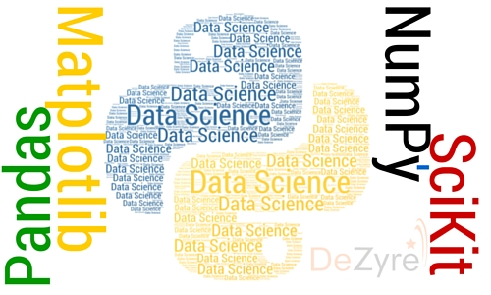

Slide 10
NumPy
Fundamental package for scientific computing with Python.
  a powerful N-dimensional array object
  sophisticated (broadcasting) functions
  tools for integrating C/C++ and Fortran code
  useful linear algebra, Fourier transform, and random number capabilities
NumPy’s main object - homogeneous multidimensional array.

Slide 11
Let’s get going !
Attributes of numpy array
  ndim: the number of axes (dimensions) of the array.
  shape: the dimensions of the array.
  size: the number of elements in the array.
  dtype: the datatype of the elements.
  data: the buffer containing the elements of the array.

Slide 12
Examples
Examples on GitHub

Slide 13
MatplotLib
Fundamental package for scientific computing with Python.
Can be used in Python scripts, the Jupyter notebook and web application servers.
Can generate plots, histograms, power spectra, bar charts, errorcharts, scatterplots

Slide 14
Examples
Examples on GitHub

Slide 15
Some useful modules/frameworks
AstroPy
Jupyter Notebook
IPython

Slide 16
“The joy of coding Python should be in seeing short, concise, readable classes that express a lot of action in a small amount of clear code -- not in reams of trivial code that bores the reader to death.”
- Guido van Rossum (author of Python, BDFL)

Slide 17

Thanks!

